Slide 1
6 G
A step towards
Intelligent Internet
Abhishek Vaid, Rishabh Pandey Presented To: San Jose State University Navrati Saxena

Slide 2
Table of Contents
Introduction
Driving Force for 6G
Applications
Features of 6G
Motivation for using AI in 6G
Related Work
Artificial Intelligence in Wireless Networks
Reducing the Congestion
Q-Learning
Results
Challenges & Future Research

Slide 3


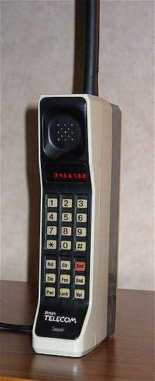

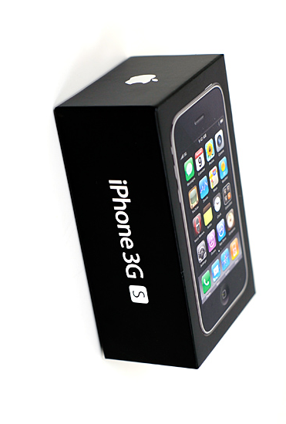
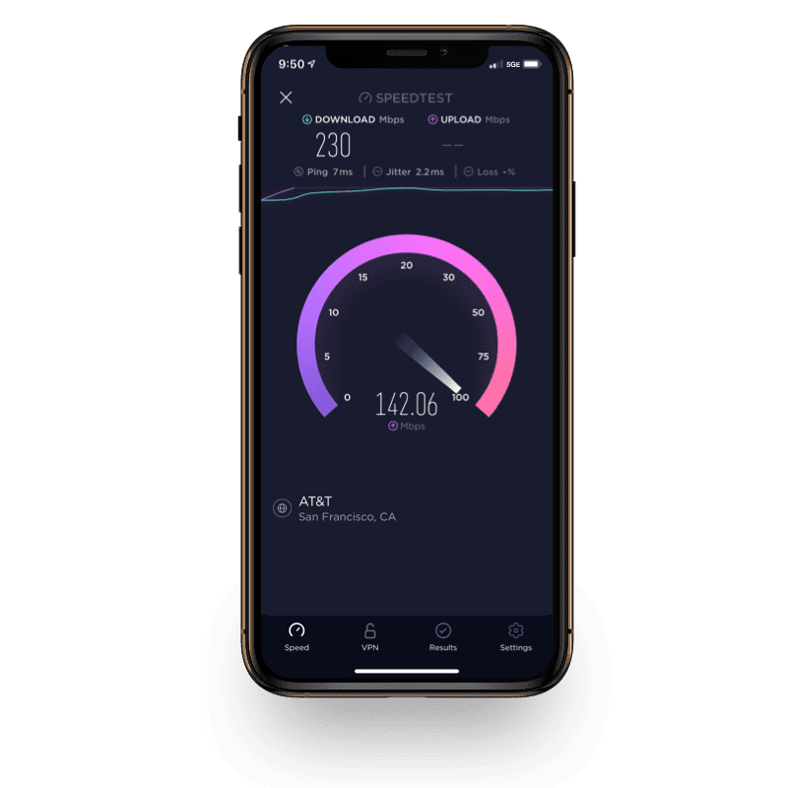
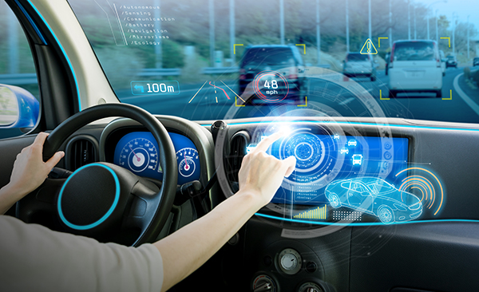

Introduction: The journey to 6G
1G
2G
3G
4G
5G
Analog Communication
First time calling available on Mobile Devices
Digital Communication
Support for both Voice & Data
Mobile Broadband
Support for multimedia applications
All IP Communication
Support for HD video streaming, online gaming, VOIP
uRLLC, mMTC, and eMBB
IOT, VR, IOV, M2M and many more
6G

Slide 4
Introduction: The journey to 6G (contd.)
Parameter | 4G | 5G | 6G (expected)
Peak Data Rate | 1 Gbps | 10 Gbps | 1Tbps
Mobility Support | Up to 350 Km/hr | Up to 500 Km/hr | Up to 1000 Km/hr
AI Support | No | Partial | Fully
End to end Latency | 100 ms | 10 ms | 0.01 ms
THz Communication | No | Very Limited | Widely used
Service Level | Video | AR, VR | Tactile
Autonomous Vehicles | No | Partial | Fully

Slide 5
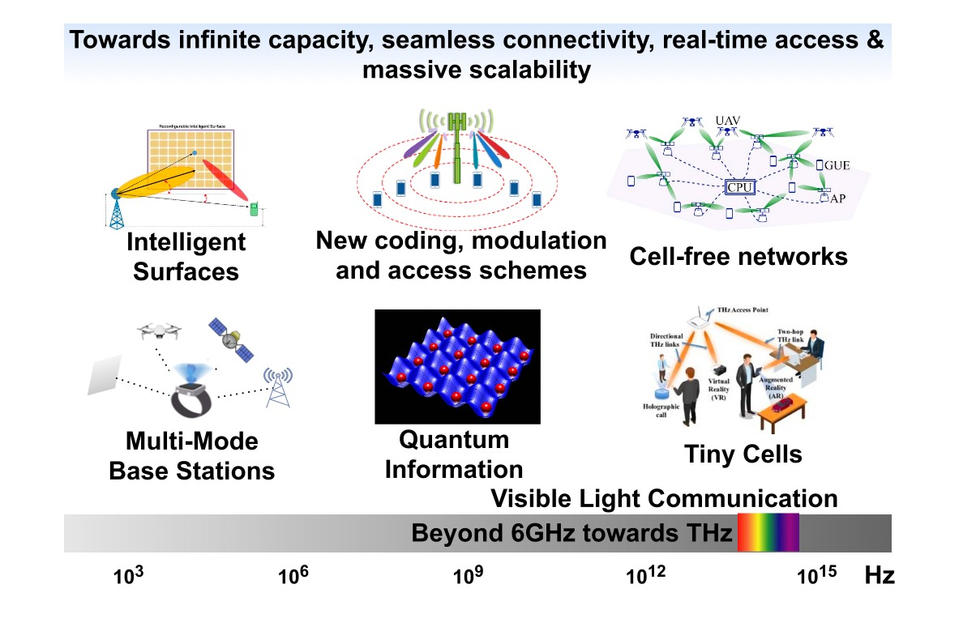
Driving Force for 6G
IOT expansion: Moving form IOT to IOE
Availability of Small Data ( A shift from Big Data)
Gadget Free Communication
Advancement of Communication Technologies
Connectivity dependent technologies
Aging Population
Fig: Communication Technologies enabling 6G [1]
[1]: Source: C. D. Alwis et al., "Survey on 6G Frontiers: Trends, Applications, Requirements, Technologies and Future Research," in IEEE Open Journal of the Communications Society, vol. 2, pp. 836-886, 2021, doi: 10.1109/OJCOMS.2021.3071496.

Slide 6
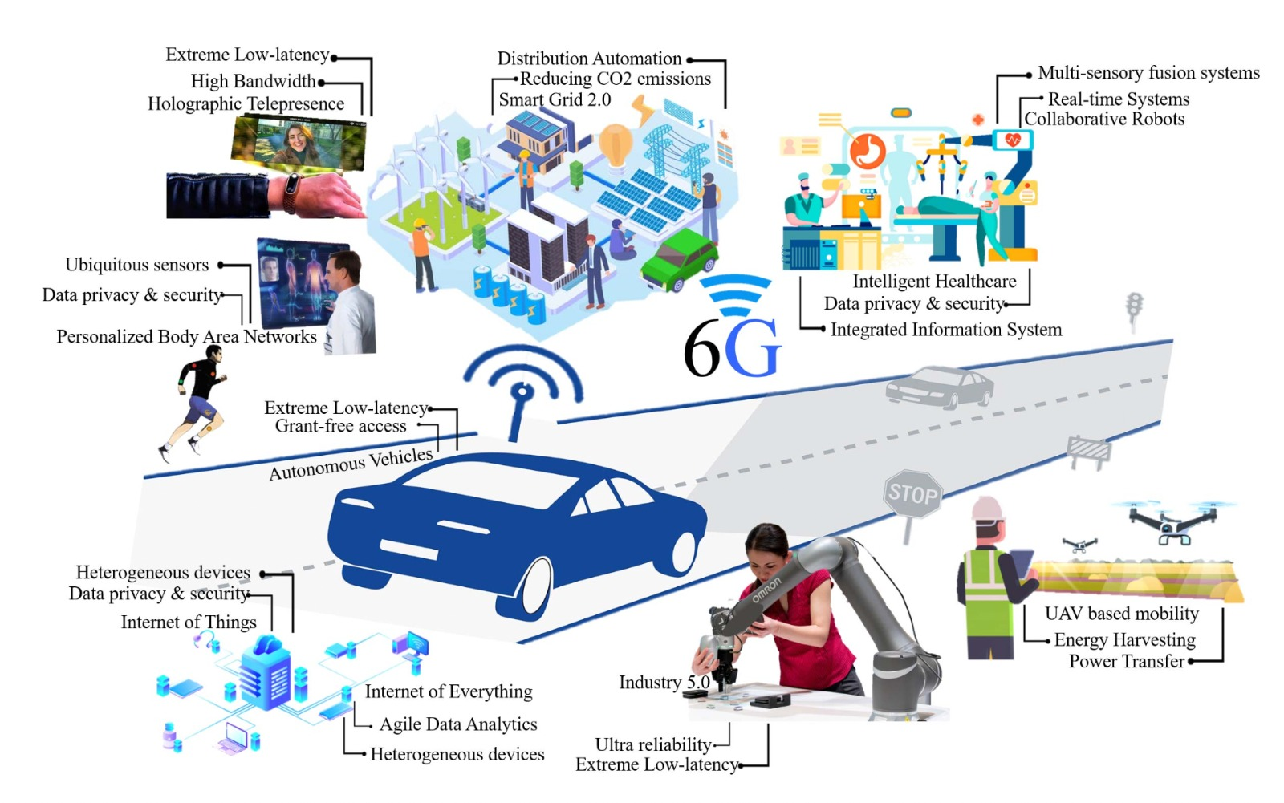
Applications
Holographic Telepresence
Extended Reality
Unmanned Aerial Vehicles
Connected Vehicles
Space and Deep Sea Tourism
Smart Grids
Hepatic Communication
Fig: Prospective applications of 6G [1]
[1]: Source: C. D. Alwis et al., "Survey on 6G Frontiers: Trends, Applications, Requirements, Technologies and Future Research," in IEEE Open Journal of the Communications Society, vol. 2, pp. 836-886, 2021, doi: 10.1109/OJCOMS.2021.3071496.

Slide 7

Features of 6G (expected)
Peak data rates over 1 Tbp/s
Ultra reliable network, almost zero delays
Connection density of 10¹⁷ devices/km²
Support Mobility up to 1000 kmph
Mobile Broadband and Low Latency (MBLL)
Ultra-massive Machine-Type Communication (umMTC)
Enhanced Energy Efficiency
Machines as Primary Users

Slide 8

Features of 6G (expected) contd.
Ultra-massive MIMO
Super Narrow Beams
Non Orthogonal Multiple Access (NOMA)
Higher power to users with worse channel conditions
Space, Air, Ground, Sea Integrated Network
Device to Device Communication
Use of Unlicensed spectrum

Slide 9
Motivation for AI in 6G
Rollout of 5G has opened new possibilities
Proposals for 6G underway
Faster Data rates desirable with every new generation
Promises for Tbp/s speed to accommodate several new applications
Importance of QoE
Deep Learning compliment potential 6G applications
Reinforcement Learning can be used to train Networks
Notes:
1 Source: C. D. Alwis et al., "Survey on 6G Frontiers: Trends, Applications, Requirements, Technologies and Future Research," in IEEE Open Journal of the Communications Society, vol. 2, pp. 836-886, 2021, doi: 10.1109/OJCOMS.2021.3071496.

Slide 10
Related Work
Z. Mammeri, "Reinforcement Learning Based Routing in Networks: Review and Classification of Approaches," in IEEE Access, vol. 7, pp. 55916-55950, 2019, doi: 10.1109/ACCESS.2019.2913776.
R. Bellman, “On a routing problem” Quarterly of Applied Mathematics. 1958
Justin A Boyan, “Reinforcement Learning for Network Routing”. 1994
L.R Ford Jr. , “Flows in Networks” Princeton University. 1962
H. Rudin, "On Routing and "Delta Routing": A Taxonomy and Performance Comparison of Techniques for Packet-Switched Networks," in IEEE Transactions on Communications, vol. 24, no. 1, pp. 43-59, January 1976, doi: 10.1109/TCOM.1976.1093202.
Notes:
1 Source: C. D. Alwis et al., "Survey on 6G Frontiers: Trends, Applications, Requirements, Technologies and Future Research," in IEEE Open Journal of the Communications Society, vol. 2, pp. 836-886, 2021, doi: 10.1109/OJCOMS.2021.3071496.

Slide 11
Artificial Intelligence in Wireless Networks
Advancements in AI after mid-2000s have shown tremendous potential
Machine Learning needed to meet the goal of real time communications in 6G wireless systems
AI and ML for increasing performance and reduce processing delays
AI can be used to perform time critical tasks such as Handovers
AI for Network selection
Time Critical applications would need real time data to give best results
Reinforcement Learning can be used to train the Network and help in adaptive transmission

Slide 12
Reducing the Congestion
Congestion in Network cause of “Lags” / “Delays”
When a certain number of data packets are in queue of a node they will be routed in a certain delay of time, which will represent load on network and delay in delivery time
The conventional way to solve this problem is to use the shortest path algorithm but this approach presents a significant issue
A better approach is to use Q-Learning to train the agent in order to discover and learn every possible outcome before taking a decision and developing a policy

Slide 13
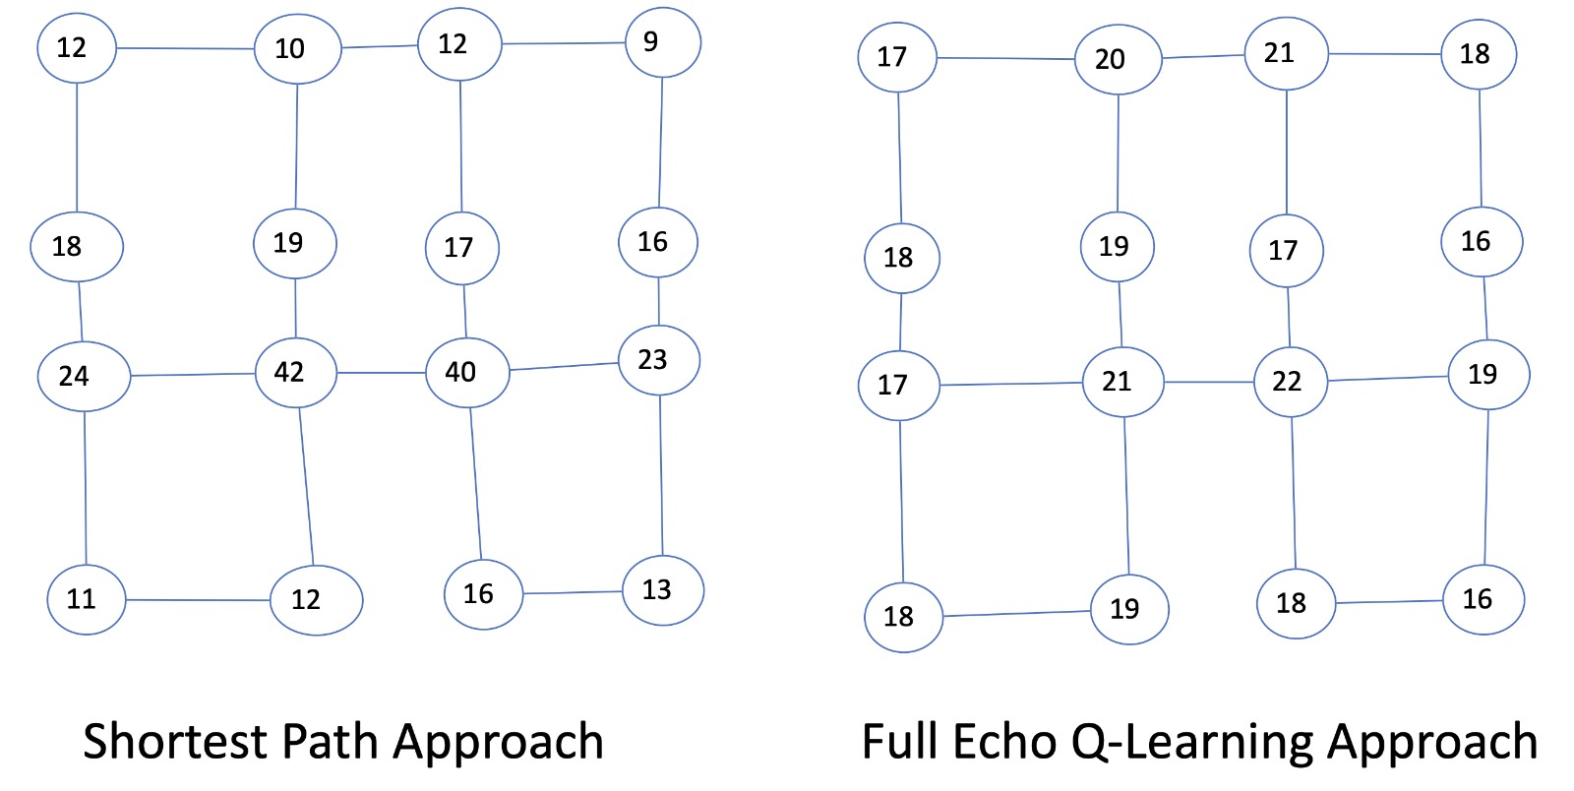
Reducing the Congestion (contd.)
Fig: Techniques to reduce Network Congestion

Slide 14
Q-Learning
S is the distance of the current node from destination node. A is the action of choosing from one of the link paths. S’ is the next destination node from the current node R reward is time in node queue plus the time take to transit from a node to another node. α is the learning rate which ranges between 0 to 1. γ is a discount factor, γ ∈[0,1].

Slide 15
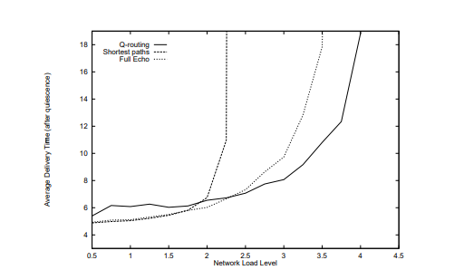
Results
Q-learning is good for high load but it is not adaptive so we suggest use of Full-echo Q-Learning
Fig: Delivery time at various loads for Q-routing and shortest paths [1]
[1] Packet Routing in Dynamically Changing Networks: A Reinforcement Learning Approach; Justin Boyan, Michael Littman

Slide 16
Challenges & Future Research
High Propagation and Atmospheric Absorption of THz frequencies
Complexities in Hardware Implementations
Security, Privacy and Trust
Extreme Global Network Coverage for Sustainable Networks
Beam Management using AI

Slide 17
References
M. Z. Chowdhury, M. Shahjalal, S. Ahmed and Y. M. Jang, "6G Wireless Communication Systems: Applications, Requirements, Technologies, Challenges, and Research Directions," in IEEE Open Journal of the Communications Society, vol. 1, pp. 957-975, 2020, doi: 10.1109/OJCOMS.2020.3010270.
T. Nakamura, "5G Evolution and 6G," 2020 International Symposium on VLSI Design, Automation and Test (VLSI-DAT), 2020, pp. 1-1, doi: 10.1109/VLSI-DAT49148.2020.9196309.
H. Tataria, M. Shafi, A. F. Molisch, M. Dohler, H. Sjöland and F. Tufvesson, "6G Wireless Systems: Vision, Requirements, Challenges, Insights, and Opportunities," in Proceedings of the IEEE, vol. 109, no. 7, pp. 1166-1199, July 2021, doi: 10.1109/JPROC.2021.3061701.
Solmaz Niknam, Abhishek Roy, Harpreet S. Dhillon, Sukhdeep Singh, Rahul Banerji, Jeffery H. Reed, Navrati Saxena, and Seungil Yoon, “ Intelligent O-RAN for Beyond 5G and 6G Wireless Networks” Available: "http://arxiv.org/abs/2005.08374v1“
Yang Lu, Xianrong Zheng, “6G: A survey on technologies, scenarios, challenges, and the related issues”, Available: https://doi.org/10.1016/j.jii.2020.100158.
Tarun S. Cousik, Vijay K. Shah, Tugba Erpek, Yalin E. Sagduyu, Jeffrey H. Reed, “Deep Learning for Fast and Reliable Initial Access in AI-Driven 6G mmWave Networks”
Yang Zhao, Wenchao Zhai, Jun Zhao, Tinghao Zhang, Sumei Sun, Dusit Niyato, Kwok-Yan Lam, “A Comprehensive Survey of 6G Wireless Communications” Available: https://arxiv.org/abs/2101.03889
H. Yang, A. Alphones, Z. Xiong, D. Niyato, J. Zhao and K. Wu, "Artificial-Intelligence-Enabled Intelligent 6G Networks," in IEEE Network, vol. 34, no. 6, pp. 272-280, November/December 2020, doi: 10.1109/MNET.011.2000195.

Slide 18
Thank You !

